Slide 1
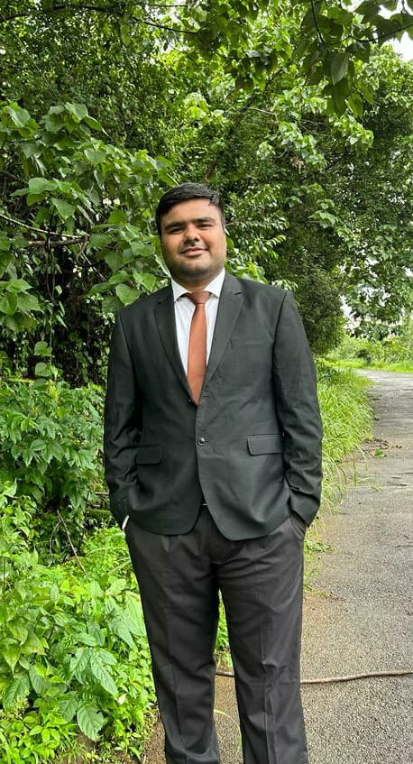
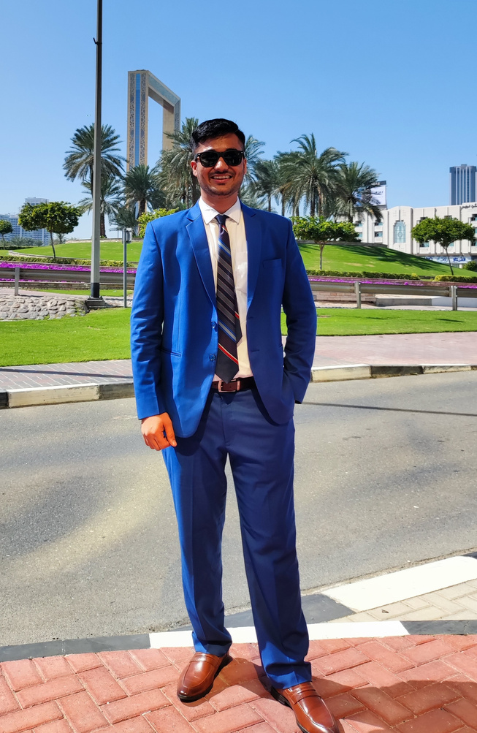
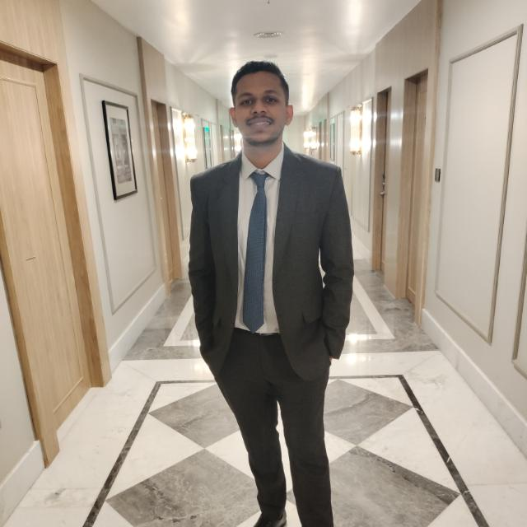
Pitch Tank 3.0
Bhavesh
Geriani
Shashank
Navandhar
Smit
Patel
“All Stars”
T.A. Pai Management Institute

Slide 2
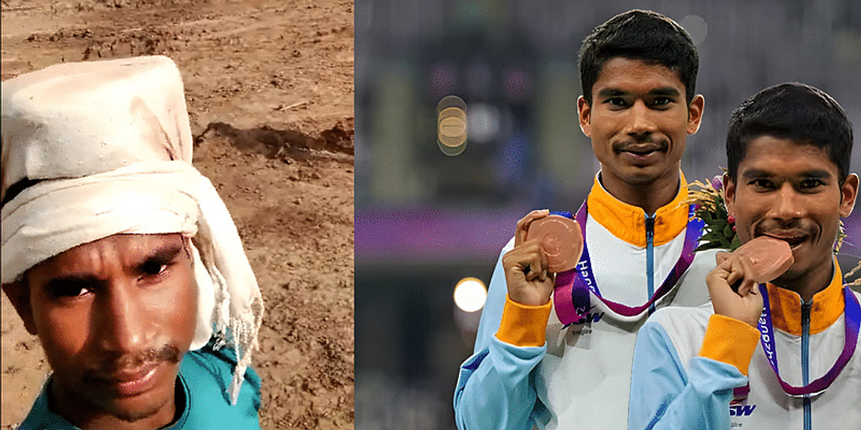

Slide 3
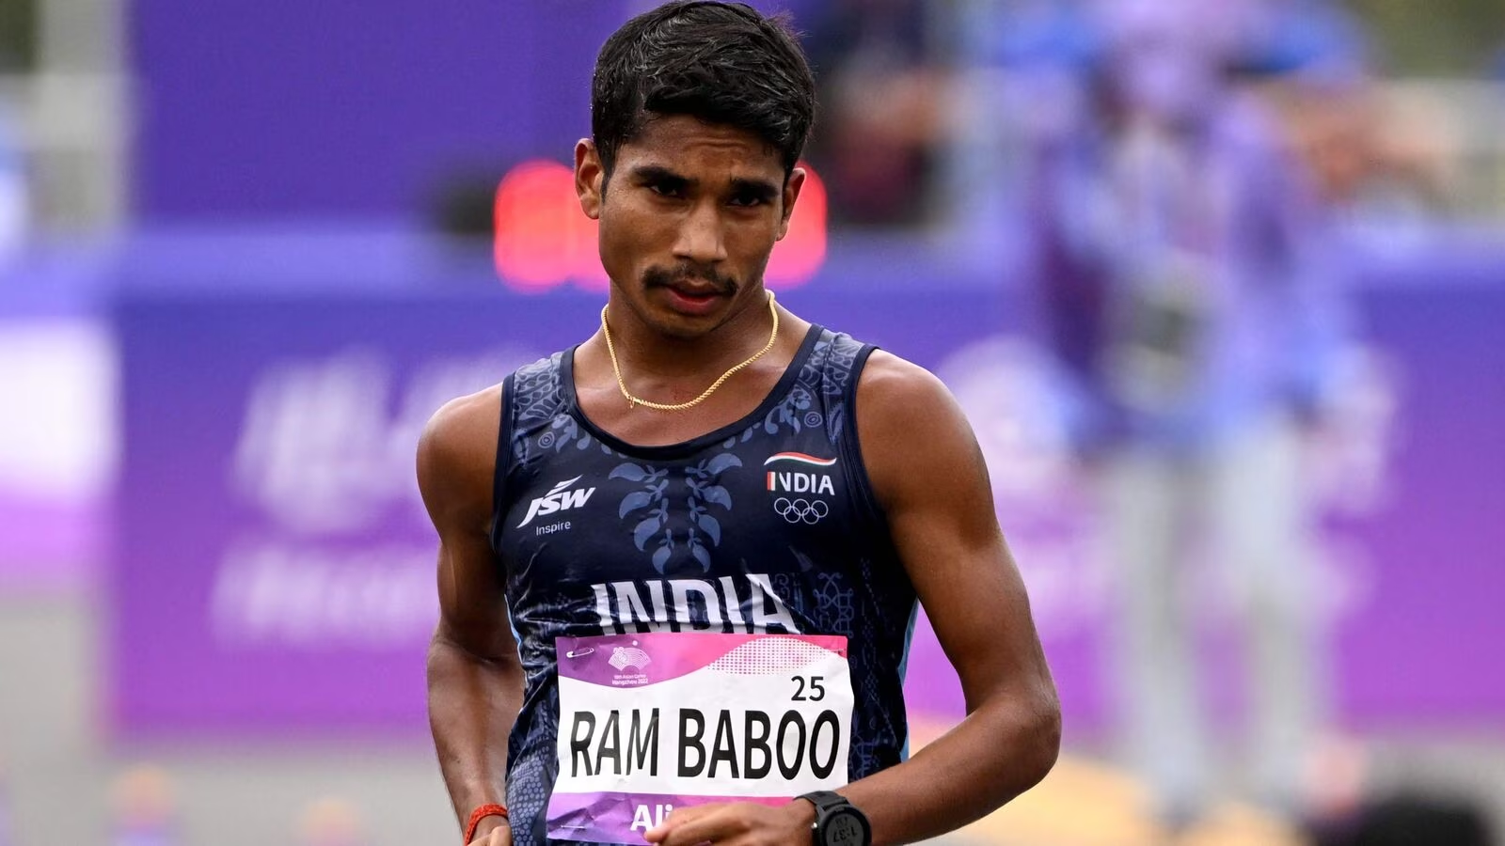

Slide 4





Growth Drivers
Rising Internet and Smartphone Penetration in India
Increasing Sports and Fitness Awareness:
Expanding Youth Demographic: India boasts a large and youthful population, with approximately 65% of people under the age of 35.
Limited Access to Quality Sports Infrastructure: Despite the increasing interest in sports, there is a notable gap in access to quality sports infrastructure, especially in rural areas.
Mobile Penetration and App Usage.
Relevance
Indian market for online sports coaching is booming, poised for substantial growth from USD 436.7 million in 2022 to USD 1,881.5 million by 2033, indicating a robust CAGR of 14.2%.
Genki seizes the opportunity of India's anticipated 1.6 billion internet users by 2026 and 1.55 billion smartphone users by 2040, leveraging the growing digital accessibility.
The market analysis reveals diverse segmentation, encompassing adults, children, and the elderly, reflecting a broad demographic interest in sports coaching.
Freemium model, aligned with market trends, offers strong monetization potential, while its regional segmentation signals scalability, paving the way for global expansion in the online sports coaching market.
TAM
Relevance Expected market characteristics
Total Available Market
SAM
436.7 Million USD
Enhanced customer experience and support
Competitive differentiation by players via technology-enabled learning solutions
Practical component of mentoring content by offering convenience and affordability
Customer feedback in terms of review and ratings would help generate trust
Government initiatives are expected to enable infrastructure support in Tier 1, Tier 2 & Tier 3 cities
Providing diverse segments an opportunity to assess free content and demo before booking the slot likely to increase adoption
Service Obtainable Market
50 Million USD
Assumption: We are planning to have Service Obtainable Market of 50 Million USD

Slide 5


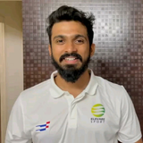
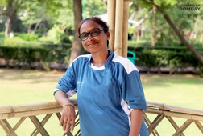
About Genki
Genki, an innovative online sports mentorship platform, emerges as a transformative force in the Indian sports landscape. With a vision to democratize sports mentorship, Genki employs cutting-edge technology, ensuring accessibility, affordability, and personalized growth for young athletes across India.
Contact us:
7382038754
snavandhar12@gmail.com
News & Updates
Book Slot
Dietician
Swimming
Football
Power lifting
Type of service
(Types of sports, mentors available, time slots)
Power Lifting Mentors
Power Lifting Mentors
Ganesh Prasad
Asian Gold Medalist - 2015
Available slots: 8 AM, 11 AM, 1 PM, 4 PM, 8 PM
Savita Gupta
Common Wealth Silver
medalist 2008
Available slots: 8 AM, 11 AM,
1 PM, 4 PM, 8 PM

Slide 6











Pre-Launch Preparation
Soft Launch &
Teacher Onboarding
Full scale Launch &
Marketing campaign
Expansion & Scaling
Evaluation &
Future Planning
Dec 2023- Jan 2024
Feb 2024 - April 2024
May 2024 - July 2024
Aug 2024 - Oct 2024
Nov 2024
Market Research and Analysis (December 2023):
Carry out in-depth market research to identify specific needs, trends, and competitive landscape.
Refine the product portfolio based on research findings.
Product Development and Enhancement (December 2023):
Finalize and enhance the existing product offerings to align with market demands.
Develop teacher-specific resources & materials for on boarding.
Mentor Engagement Strategy (January 2024):
Identify and reach out to potential mentor, highlighting the benefits of collaboration.
Prepare a comprehensive engagement plan for the upcoming launch.
GO TO MARKET
Full-Scale Launch
(May 2024):
Officially launch Genki’s mentoring program
Make the platform accessible to a wider audience, including parents, schools, and mentees.
Marketing Campaign
(June- 2024 - July 2024):
Launch a comprehensive marketing campaign that includes online advertising, social media promotion, and email marketing.
Use influencers to endorse and promote the platform within their communities.
Onboarding mentees
(August 2024 - September 2024):
Ramp up efforts to onboard mentees
Highlight the benefits of Genki's programs to school administrators.
Customer Feedback and Refinement
(October 2024):
Continuously gather feedback to make necessary improvements to the platform.
Refine the user experience based on feedback.
One-Year Evaluation (November 2024):
Assess the performance of Genki's expansion into the Sports and nutrition space.
Measure user adoption, engagement, and customer satisfaction.
Future Planning (November 2024):
Based on the one-year evaluation, plan for further growth and expansion.
Consider diversifying the product portfolio based on market feedback and emerging trends.
Soft Launch (February 2024):
Begin a soft launch of Genki' programs with a limited audience to gather initial feedback.
Mentor Onboarding
(March 2024 - April 2024):
Collaborate with selected mentor to onboard them as influencers and partners.
Provide training to mentors on how to effectively use Genki’s resources.

Slide 7








Branding
Onboarding Strategies
Social Media Presence
Partnerships with Schools
Content Creation: Share valuable (technique, form) content (articles, videos, infographics, webinars) on social media.
Engagement: Actively respond to comments, questions, and messages.
Influencer Collabs: Partner with Fitness influences, sports people to expand reach.
Consistency: Stick to a regular posting schedule for audience engagement.
Outreach Programs: Introduce Genki to schools, emphasizing benefits for students.
Selecting mentors from various domains
Highlighting the benefits of becoming a Genki mentor like flexible working hours, respect and fame.
Providing attractive compensation plans.
For mentors
Customer Support and Feedback
Prompt Support: Ensure excellent customer support by addressing user inquiries and issues promptly and professionally.
Feedback Loops: Collect and act on user feedback to continuously improve the platform's features, content, and user experience.
Word of Mouth Marketing
Referral Incentives: Reward users for referring others.
Advocacy: Encourage parents and guardians to promote Genki.
Community Building: Foster user community through forums and interaction.
Evaluation & assessment of candidates with suitable tasks
Providing in-depth knowledge of the products & offerings to the team.
Defining a clear performance metrics for the executives
For business development executives
User Testimonials and Success Stories
Community Building
Success Stories: Share mentee achievements and career growth.
Video Testimonials: Feature satisfied users discussing platform impact.
Case Studies: Detail how Genki helps mentees overcome challenges.
Online Communities: Create spaces for connection and advice.
Expert Webinars: Host sessions with sports experts.
User-Generated Content: Encourage users to share articles, success stories, and more.

Slide 8


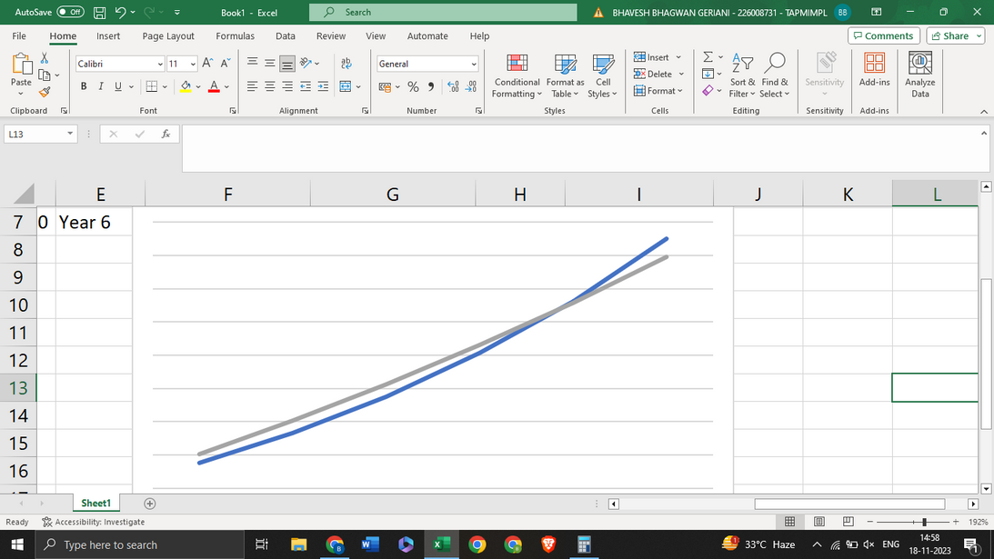

Cost Structure
Revenue
Activity | Monthly Cost (INR) | Annual Cost (INR)
Content development | 30,000 | 3,60,000
Technology development | One time | 8,40,000
Marketing & sales | 80,000 | 9,60,000
Training & Development (Twice a year) | 60,000 | 1,20,000
Administrative expenses | 75,000 | 9,00,000
Miscelleneous | 25,000 | 3,00,000
Trainers (30 sessions) | (18,000)*5*4*12 | 43,20,000
Coaches | (25,000)*12*2*4 | 24,00,000
Total |  | 1,02,00,000
Subscription Tier (City) | Price Per session (INR) | Number of mentees (60-25-15) | Revenue Per session (in INR) (Total mentees* price per session) | Total cost per source (On average 24 sessions per course) (per session revenue * 24 sessions)
Tier 1 | 800 | 300 | 2,40,000 | 57,60,000
Tier 2 | 800 | 75 | 60,000 | 14,40,000
Tier 3 | 500 | 30 | 15,000 | 3,60,000
 |  | 245 |  | 75,60,000
Note: We are planning to hire 2 primary Coaches followed by 5 trainers each for each sport segments.
Note: We are targeting to onboard 500 mentees in tier 1, 300 in tier 2 & 200 in tier 3 cities.
Assume to convert:
60% tier 1, 25% tier2 & 15% tier 3
 | Cum. Cost | Cum. Rev.
Year 1 | 1,02,00,000 | 75,60,000
Year 2 | 2,03,08,800 | 1,66,32,000
Year 3 | 3,12,26,304 | 2,75,18,400
Year 4 | 4,30,17,208 | 4,05,82,080
Year 5 | 5,57,51,385 | 5,62,58,496
Fixed Cost =
Rs. 8,40,000
Variable Cost =
Rs. 93,60,000
Breakeven Point
Assumptions taken:
Variable Cost increases by 8% annually
Revenue increases by 20% annually
Click for excel
Year 1
Year 2
Year 3
Year 4
Year 5

